Slide 1
Installing PYODBC Package in Visual Studio

Slide 2
OBJECTIVES
Explain what pyodbc is
Install the pyodbc module in a python app
Test the installation by running code that uses pyodbc

Slide 3
pyodbc is an open source Python module that makes accessing ODBC databases simple
You can install it by typing: pip install pyodbc
Or you can get Visual Studio to install it for you
You'll install and use pyodbc during this lecture as an inline exercise
What is pyodbc?

Slide 4
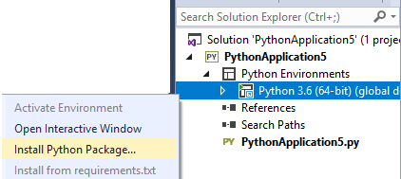
Installing pyodbc - 1
Create a python application
Open the Solution Explorer
Click the menu items shown below

Slide 5
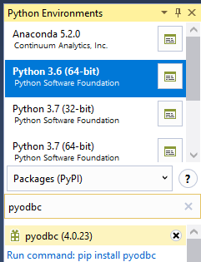
Installing pyodbc - 2
Search for pyodbc
Select this link

Slide 6
Try pyodbc to fetch a rows
Copy and past the following code to test pyodbc is installed
The code will be explained in the next chapter
Ask your trainer if the table content is not shown
import pyodbc
connectionString = r'DRIVER={ODBC Driver 13 for SQL Server};SERVER=.\SQLExpress;DATABASE=qastore;Trusted_Connection=yes'
conn = pyodbc.connect(connectionString)
cur = conn.cursor()
result = cur.execute('SELECT * FROM company').fetchall()
conn.close()
for row in result:
print(row)

Slide 7
OBJECTIVES
Explain what pyodbc is
Install the pyodbc module in a python app
Test the installation by running code that uses pyodbc
No lab for this chapter as you've performed an inline lab

Slide 8
Any Questions?

Slide 9
Thank you

